Slide 1
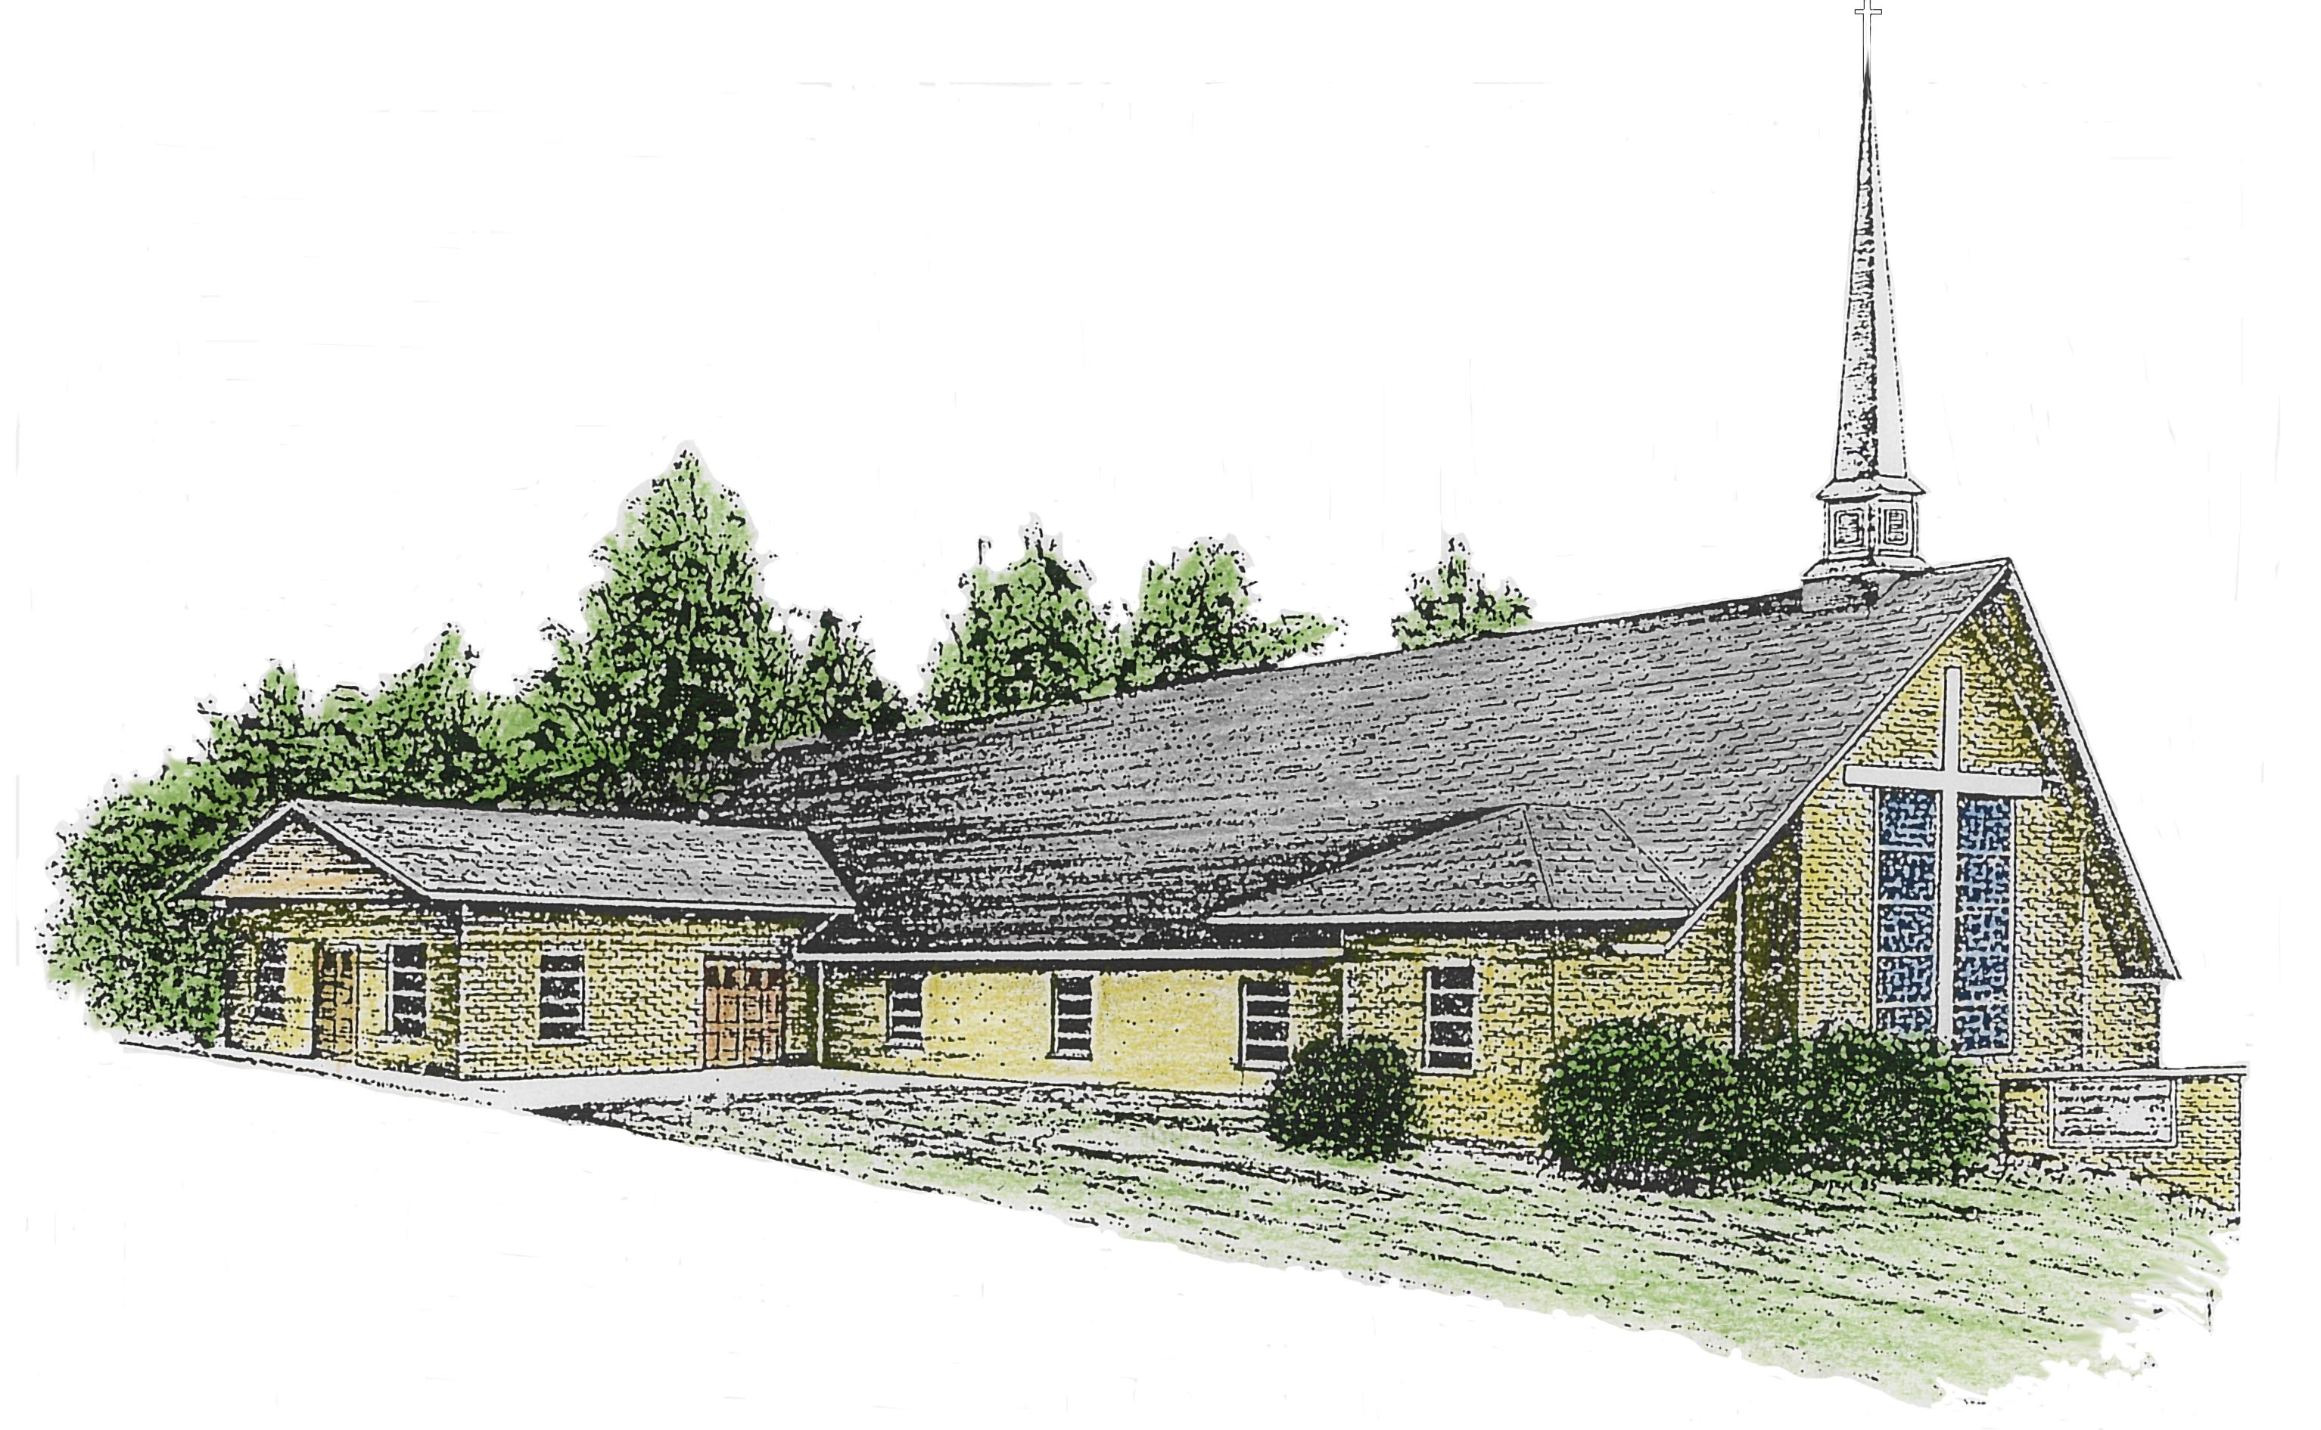
WELCOME TO THE RIVER DRIVE CHRISTIAN CHURCH

Slide 2

Birthdays
Alyssa Sparks
Monday

Slide 3
Standing On The Promises 122
(VS 1,2 &4)

Slide 4

Standing on the promises of
Christ my King,
Through eternal ages let His praises ring,
Glory in the highest,
I will shout and sing,
Standing on the promises of God

Slide 5
Standing, standing,
Standing on the promises of
God my Savior;
Standing, standing,
I’m standing on the promises of God

Slide 6
Standing on the promises that cannot fail,
When the howling storms of doubt and fear assail,
By the living Word of God I shall prevail,
Standing on the promises of God.

Slide 7
Standing, standing,
Standing on the promises of
God my Savior;
Standing, standing,
I’m standing on the promises of God

Slide 8
Standing on the promises I cannot fall,
List’ning every moment to the Spirit’s call,
Resting in my Savior as my all in all,
Standing on the promises of God.

Slide 9
Standing, standing,
Standing on the promises of
God my Savior;
Standing, standing,
I’m standing on the promises of God

Slide 10
Rock Of Ages 315
(VS 1,2&3 )

Slide 11
Rock of Ages, cleft for me,
Let me hide myself in Thee;
Let the water and the blood,
From Thy wounded side which flowed,
Be of sin the double cure;
Save from wrath and make me pure.

Slide 12
Could my tears forever flow
Could my zeal no respite know
This for sin could not atone;
Thou must save, and Thou alone.
In my hand no price I bring,
Simply to Thy cross I cling.

Slide 13
While I draw my final breath,
When mine eyes shall close in death,
When I rise to worlds unknown,
And Behold Thee on Thy throne,
Rock of Ages, cleft for me,
Let me hide myself in Thee.

Slide 14
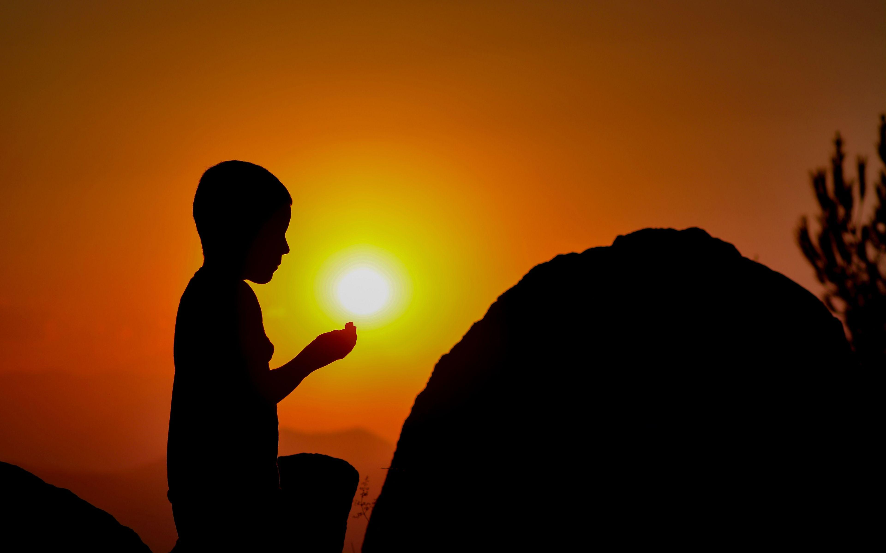
PRAYER REQUEST

Slide 15
Prayer Hymn:
Sweet Hour Of Prayer 414
(VS 1,2&3)

Slide 16
Sweet hour of prayer! sweet hour of prayer! That calls me from a world of care, And bids me at my Father’s throne
Make all my wants and wishes known.
In seasons of distress and grief,
My soul has often found relief, And oft escaped the tempter’s snare,
By thy return, sweet hour of prayer!

Slide 17
Sweet hour of prayer! sweet hour of prayer! Thy wings shall my petition bear To Him whose truth and faithfulness Engage the waiting soul to bless. And since He bids me seek His face, Believe His Word and trust His grace, I’ll cast on Him my every care, And wait for thee, sweet hour of prayer!

Slide 18
Sweet hour of prayer! sweet hour of prayer! The joys I feel, the bliss I share,
Of those whose anxious spirits burn
With strong desires for thy return!
With such I hasten to the place
Where God my Savior shows His face,
And gladly take my station there,
And wait for thee, sweet hour of prayer!

Slide 19


Slide 20
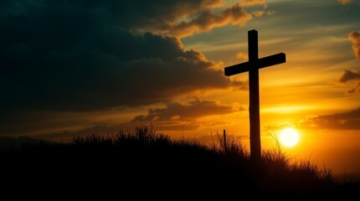
Communion Hymn:
Nothing But The Blood 269
(VS 1,2&4)

Slide 21
What can wash away my sin?
Nothing but the blood of Jesus;
What can make me whole again?
Nothing but the blood of Jesus.

Slide 22
Oh! precious is the flow
That makes me white as snow;
No other fount I know,
Nothing but the blood of Jesus.

Slide 23
For my pardon, this I see,
Nothing but the blood of Jesus;
For my cleansing this my plea,
Nothing but the blood of Jesus.

Slide 24
Oh! precious is the flow
That makes me white as snow;
No other fount I know,
Nothing but the blood of Jesus.

Slide 25
This is all my hope and peace,
Nothing but the blood of Jesus;
This is all my righteousness,
Nothing but the blood of Jesus.

Slide 26
Oh! precious is the flow
That makes me white as snow;
No other fount I know,
Nothing but the blood of Jesus.

Slide 27
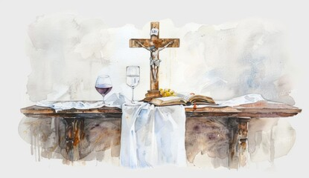
Do This In Remembrance of Me

Slide 28


Slide 29

Morning Message:
Tim Jones
“Rock Of Ages”
Matthew 7:21-28

Slide 30
²¹ “Not everyone who says to me, ‘Lord, Lord,’ will enter the kingdom of heaven, but only the one who does the will of my Father who is in heaven. ²² Many will say to me on that day, ‘Lord, Lord, did we not prophesy in your name and in your name drive out demons and in your name perform many miracles?’

Slide 31
²³ Then I will tell them plainly, ‘I never knew you. Away from me, you evildoers!’
²⁴ “Therefore everyone who hears these words of mine and puts them into practice is like a wise man who built his house on the rock.

Slide 32
²⁵ The rain came down, the streams rose, and the winds blew and beat against that house; yet it did not fall, because it had its foundation on the rock. ²⁶ But everyone who hears these words of mine and does not put them into practice is like a foolish man who built his house on sand.

Slide 33
²⁷ The rain came down, the streams rose, and the winds blew and beat against that house, and it fell with a great crash.”
²⁸ When Jesus had finished saying these things, the crowds were amazed at his teaching,

Slide 34
Morning Message:
Tim Jones
“Grandparents”
I Timothy 1:3-5

Slide 35
Invitation Hymn:
“Tis So Sweet Trust in Jesus 324
(VS 1&2)

Slide 36
‘Tis so sweet to trust in Jesus,
And to take Him at His Word;
Just to rest upon His promise,
And to know, “Thus says the Lord!”

Slide 37
Jesus, Jesus, how I trust Him!
How I’ve proved Him o’er and o’er
Jesus, Jesus, precious Jesus!
O for grace to trust Him more!

Slide 38
O how sweet to trust in Jesus,
Just to trust His cleansing blood;
And in simple faith to plunge me
‘Neath the healing, cleansing flood!

Slide 39
Jesus, Jesus, how I trust Him!
How I’ve proved Him o’er and o’er
Jesus, Jesus, precious Jesus!
O for grace to trust Him more!

Slide 40

Closing Song:
Blest Be the Tie That Binds 135
(Vs 1)

Slide 41
Blest be the tie that binds
Our hearts in Christian love;
The fellowship of kindred minds
Is like to that above.

Slide 42
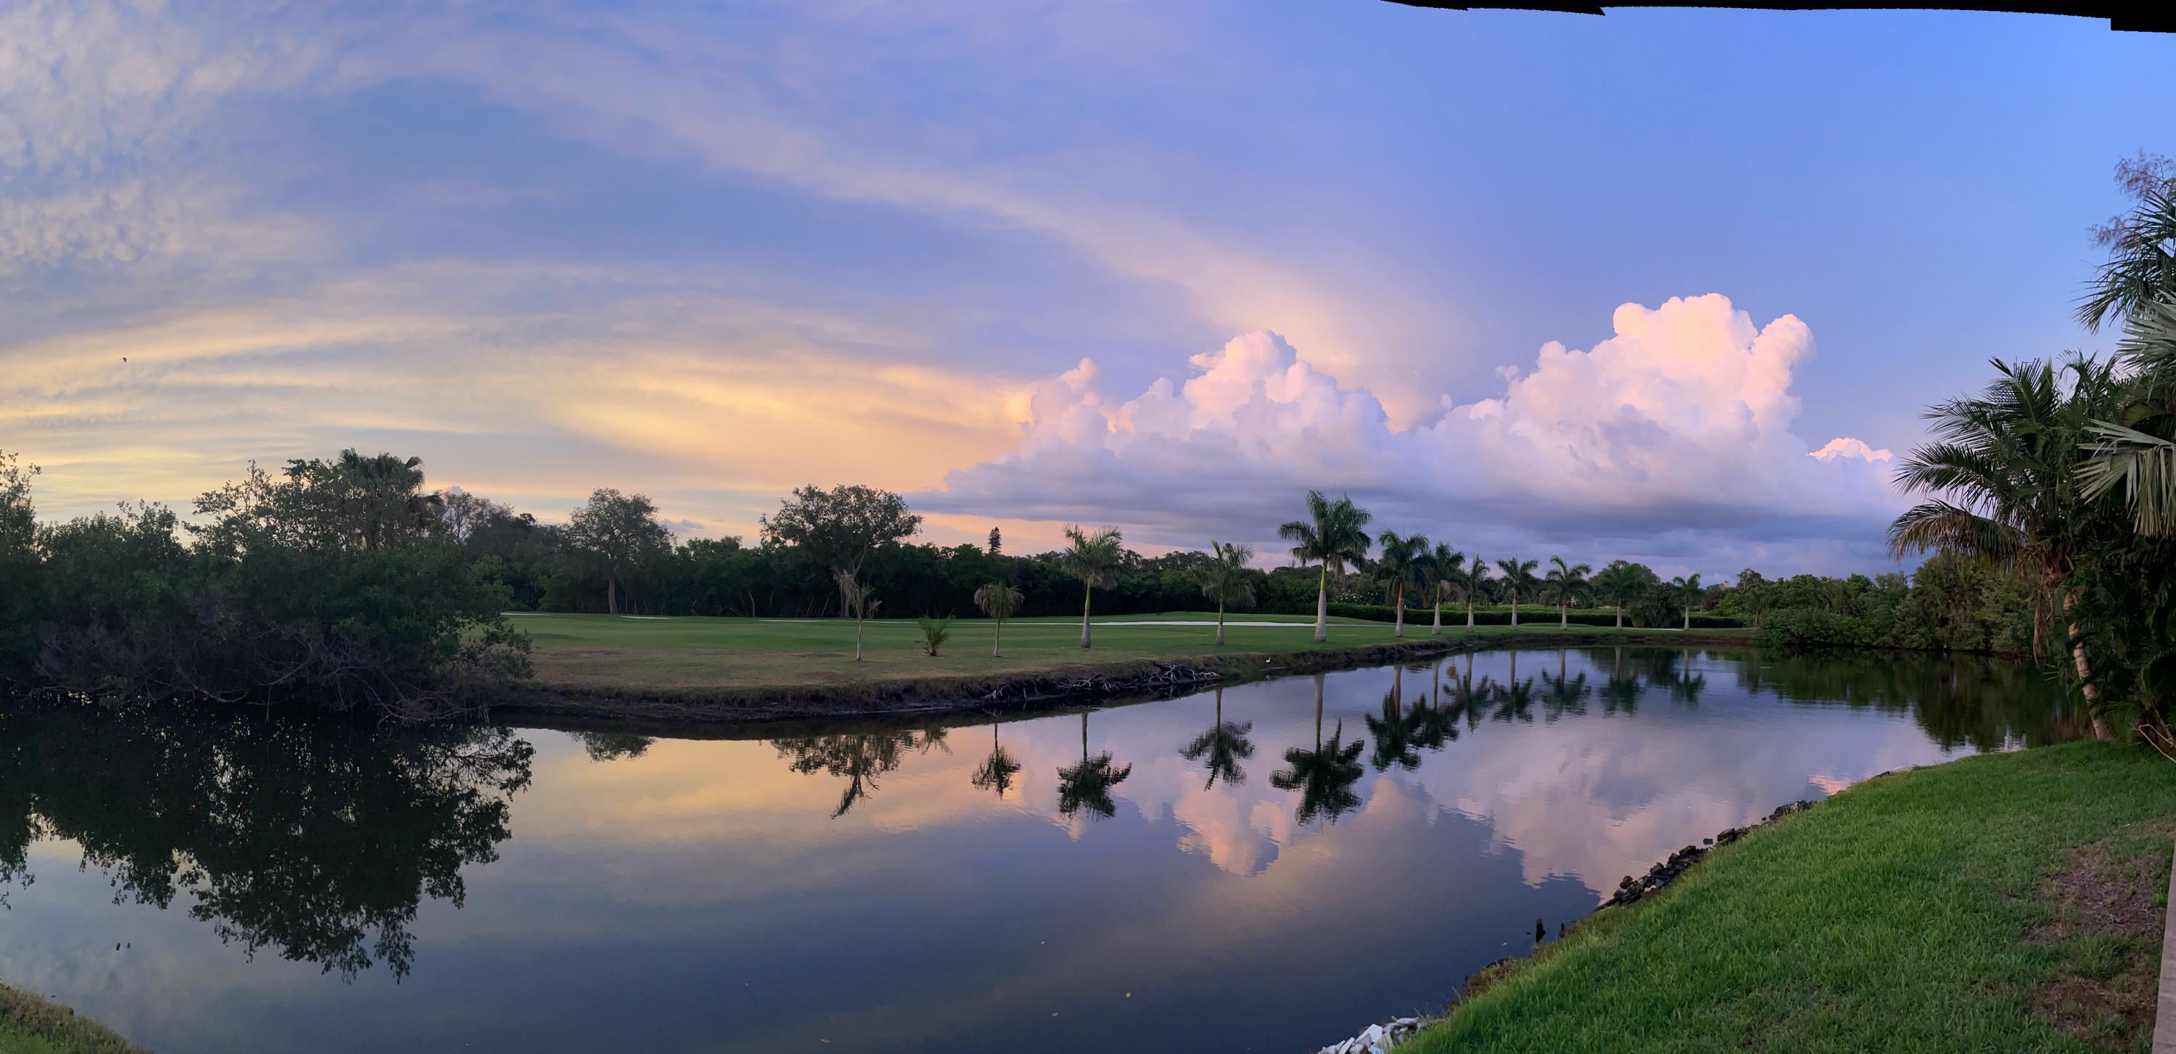
HAVE A BLESSED WEEK!
looked up to heaven and saw the glory of God.

